Slide 1

Phase-V Defining the Sketch of the Solving Methodology Research on Chest X-rays to deduct various respiratory infections
Guided by: Dr. Sabah Mohammed
Mohan Prasad Kutala
mkutala@lakeheadu.ca

Slide 2
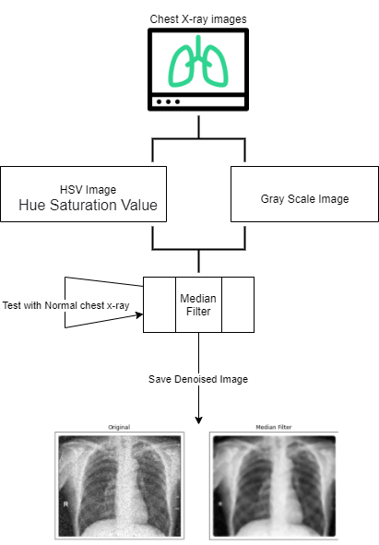
Methodology to reduce the noise our the X-ray Images
To reduce salt and pepper noise we have so many filters to reduce but in those filters I am going to select the median filter
Advantages of using Median Filter:
→ it preserves edges whilst removing noise
entry by entry, replacing each entry with the median
widely used as smoothers for image processing
eliminate the effect of input noise values with extremely large magnitudes
Disadvantages of Other filters:
Replace the centre pixel with mean of other entries
Artifacts on a colour image
Linear filters
This means that for two images A(x) and B(x):

Slide 3
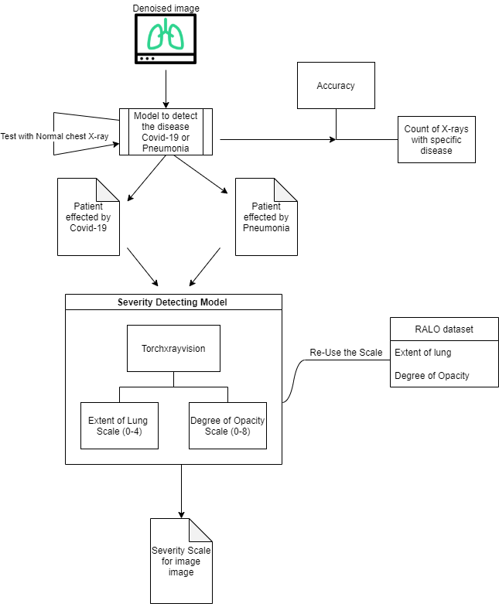
Methodology to detect the covid-19 severity in Chest X-rays
Implement one deep learning model to detect whether the x-ray consists of pneumonia or covid-19
should return the accuracy
table with count of x-rays having covid-19 and pneumonia disease.
for example in a given input it will show as
X images has affected by pneumonia
Y images are affected by Covid-19
remaining images are neutral or normal.
* Severity Detecting model will take single image as input and will return the scale score based on the RALO.

Slide 4
Methodology to detect the Pneumonia in Chest X-rays
Severity Scale can be taken from RALO (Radiographic Assessment of Lung Opacity) dataset in which Radiological scoring was performed by three blinded experts: two chest radiologists (each with at least 20 years of experience) and a radiology resident.
They staged disease severity using a score system, based on two types of scores
Extent of lung:
0 = no involvement
1 = <25% involvement
2 = 25%-50% involvement
3 = 50%-75% involvement
4 = >75% involvement.
Degree of Opacity :
0 = no opacity
1 = ground glass opacity
2 = consolidation
3 = mix of consolidation and ground glass opacity (>50% consolidation)
4 = white-out
The total opacity score ranged from 0 to 8 (right lung and left lung together).

Slide 5


